Slide 1

IE 5334 - 001
LOGISTIC DISTRIBUTION SYSTEM
LDS – KEY ASSIGNMENT
JATIN SHARMA - 1002071716
NIMISH SHETTY - 1002075335
KAJAL WAGHMARE - 1002070226
VAIBHAV THAPLIYAL - 1002070162

Slide 2
EXECUTIVE SUMMARY
The introduction of pick to light system in our warehouse has resulted in significant improvements in accuracy and efficiency. This technology allows workers to easily locate items within the warehouse by using lights to guide them to the appropriate location. By removing the need for manual searches, the time required to locate items has been reduced, resulting in faster processing times and improved order fulfilment rates. Additionally, the system will improve accuracy by reducing the likelihood of errors that can occur with manual searches. As a result, the pick-to-light system has been a valuable addition to our warehouse operations, enabling us to streamline our workflow and better serve our customers.
we will be implementing cross-docking in our warehouse, which will bring significant improvements in our operational efficiency and utilization of space. Cross docking is a supply chain strategy that streamlines the flow of goods by directly transferring incoming products from one truck to another for immediate shipping without the need for intermediate storage. With this strategy, we can significantly reduce handling times and operational costs, making our operations more efficient, productive, and cost-effective. Furthermore, cross-docking enables us to optimize the utilization of our warehouse space, reducing the need for long-term storage and freeing up more space for other critical operations. We are confident that this new strategy will bring tremendous benefits to our business.

Slide 3
we have made a significant change in our order-picking process. As mentioned in the previous slide, we have eliminated the Pick-to-Voice picking process and replaced it with Pick-to-Light technology. This change will bring several benefits to our operations, including higher accuracy, increased speed, and improved efficiency. Pick-to-Light technology is a hands-free, paperless, and visual-based system that guides pickers to the exact location of the item they need to pick, reducing the chance of errors and improving the speed of order picking. With this new technology, we can process more orders in less time, reducing lead times, and delivering our products faster and more reliably.
We have shortened the conveyor, which will aid us in lowering the costs of saving space, which will improve space utilization. Additionally, the extra room created by shrinking the size would allow us to use that particular area for storage or other purpose.
LENGTH OF CONVEYOR EARLIER = 1306 Ft
LENGTH OF CONVERY (AFTER REDUCING THE LENGTH) = 1096
TOTAL COST SAVING = (1306-1096)*$100/FT = $210,000

Slide 4
DATA PROFILING

Slide 5
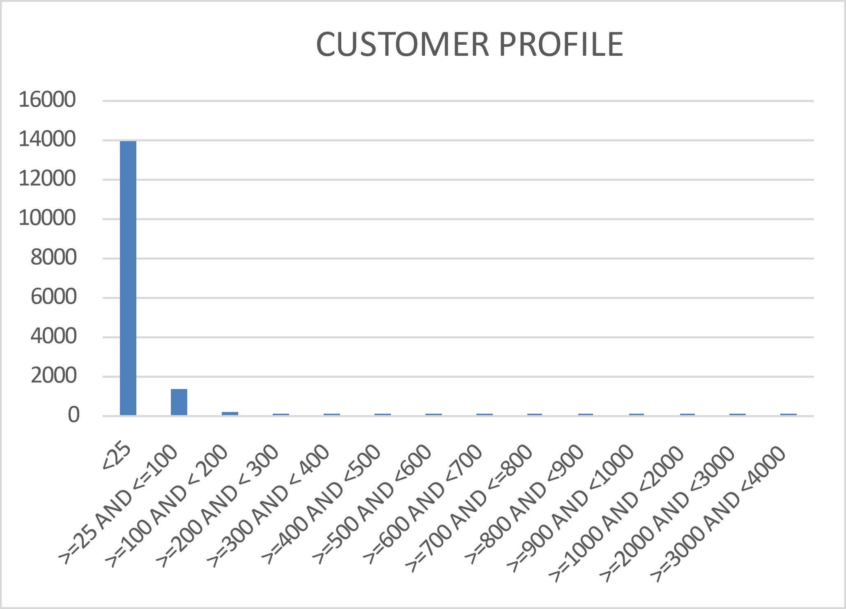
CUSTOMER PROFILE
It is quite conspicuous from the bar chart that the majority of the quantity is ordered by a smaller number of people.

Slide 6
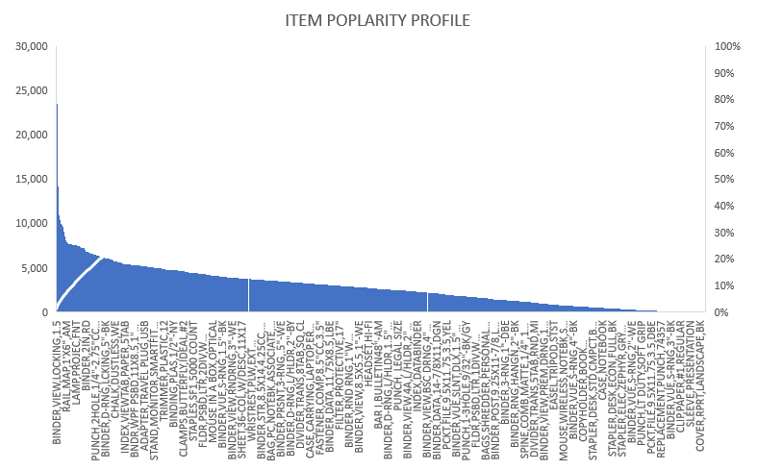
ITEM POPULARITY PROFILE
The item popularity profile reveals that Binder, View, and Locking are the most ordered products/ goods. In addition, compared to the other products, clip paper, binder, ordinary sleeves, presentation covers, reports, and landscape, BK is the least popular and receives fewer orders.

Slide 7
INVENTORY PROFILE

Slide 8
ORDER PROFILE

Slide 9
ORDER PROFILE

Slide 10
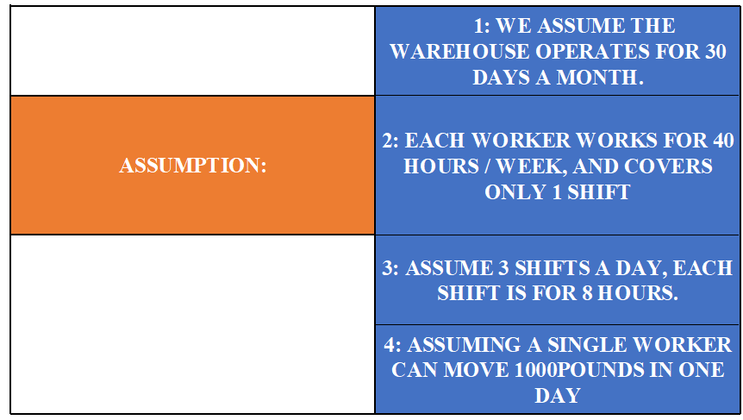
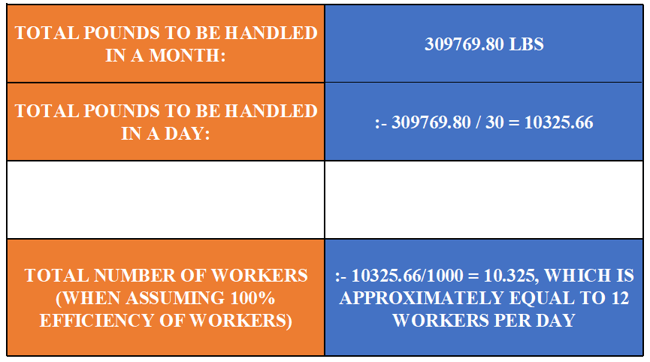
LABOUR REQUIREMENT

Slide 11
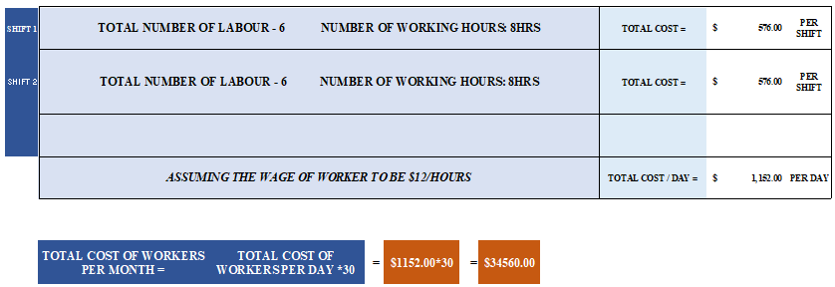

Slide 12
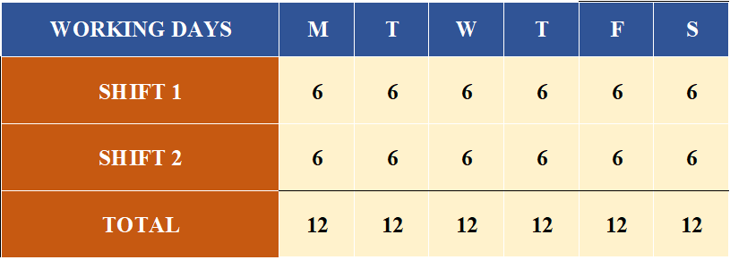
SHIFT PLAN

Slide 13
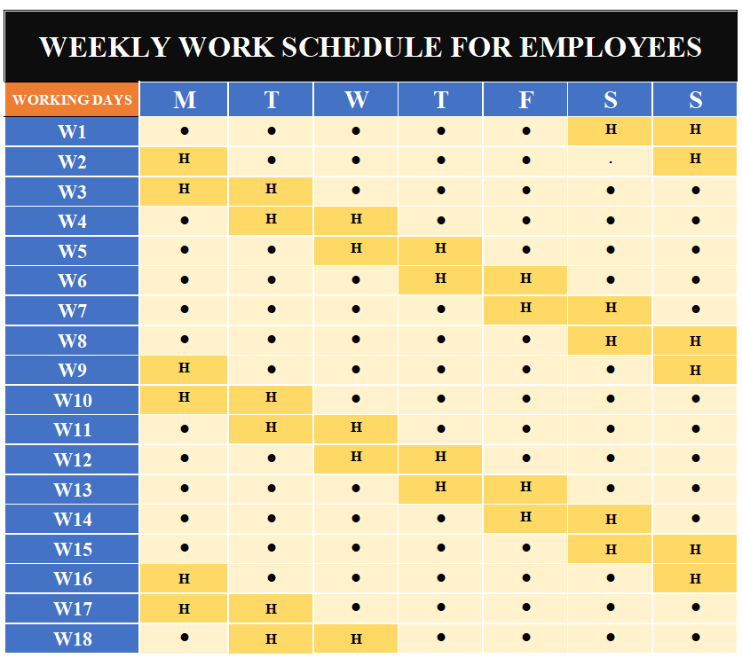

Slide 14
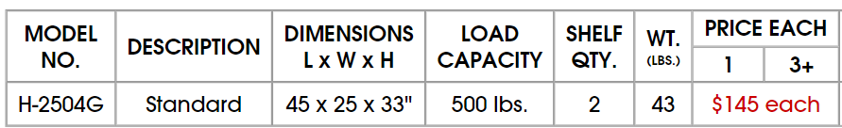
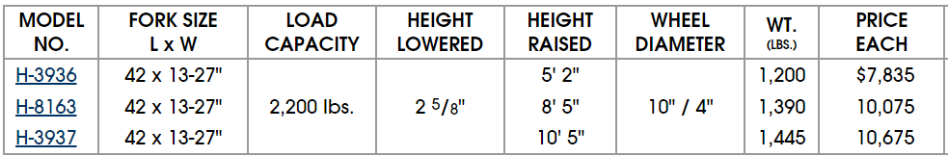
MATERIAL HANDLING EQUIPMENT
ULINE UTILITY CART - 45 X 25 X 33“
FULLY POWERED STACKERS
Forklift (for bulk storage)
capacity: 5000lbs, forklift size: 2.5m x 2.5m

Slide 15
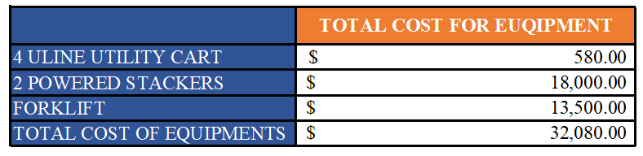
MHE TOTAL COST

Slide 16
PROPOSED TECHNOLOGY SOLUTION
The proposed technology solution changes the pick-to-voice method with pick-to-light picking, which reduces the cost. In addition to this, it increases the accuracy, by providing a specific number of SKUs to be picked.
TOTAL COST OF INTRODUCING = 112*2*150 = $33600.00
PICK TO LIGHT SYSTEM

Slide 17
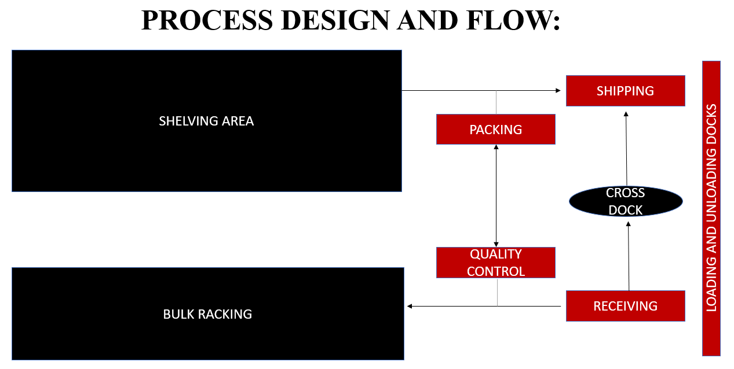

Slide 18
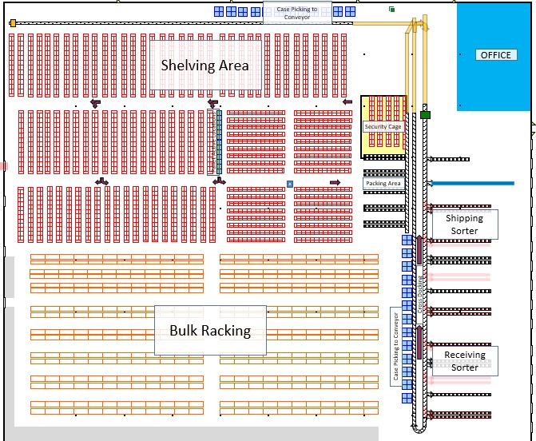
LAYOUT

Slide 19
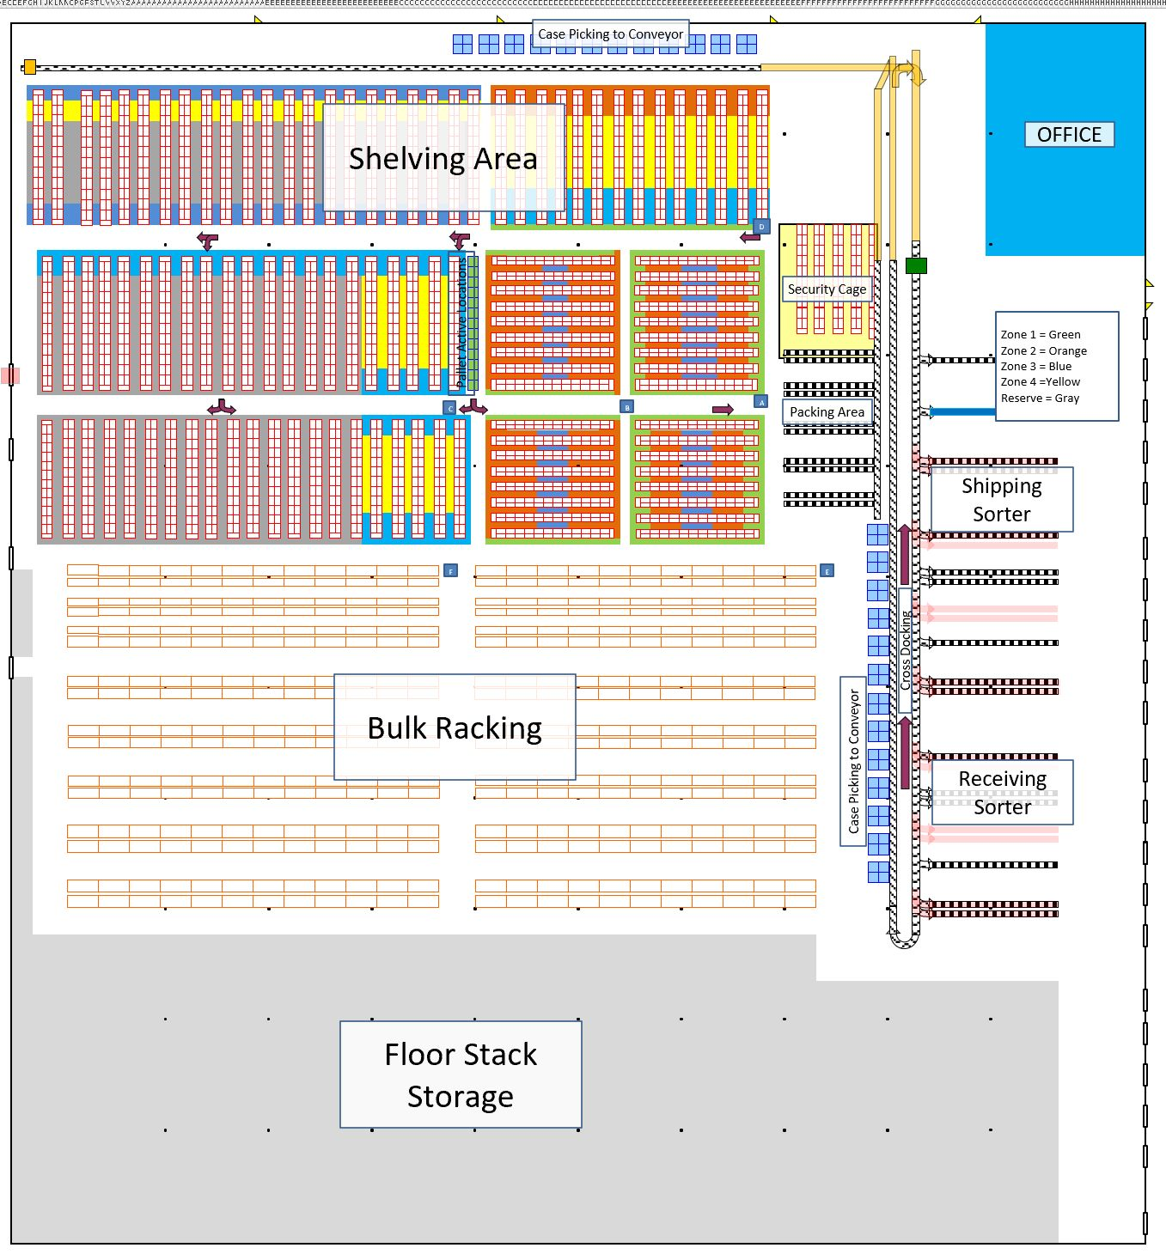
VELOCITY ZONES

Slide 20
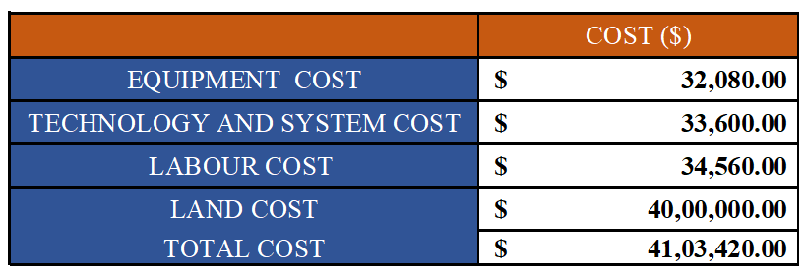
INVESTMENT COST ESTIMATE

Slide 21
DESIGN ASSUMPTION
Labor productivity is assumed for the operations, they can vary based on work.
Some investment prices are based on online resources, and they may vary depending on the nation and state of the market.
Data will follow a similar pattern in the future as well.
Assume 2 shifts a day, each shift is for 12 hours.
Each worker works for 40 hours/week and covers only 1 shift.

Slide 22
THANK - YOU

